Slide 1
CAPSTONE PROJECT-02
JOB MARKET ANALYSIS
TEAM ID: PTID-CDA-OCT-25-803
PROJECT ID: PRDA-04 JOB MARKET ANALYSIS
ADITYA HINGRAJIYA

Slide 2
INTRODUCTION
This project presents a data-driven analysis of the current job market, covering regional hiring trends, industry demand, and the impact of skills and education on career growth. Using structured analytics, the study identifies where job opportunities are expanding, which sectors offer the highest demand, and how salary patterns vary across different regions. The analysis further uncovers the role of qualifications and technical skills in influencing employability and earning potential. By integrating state-wise, industry-wise, and skill-based insights, the project highlights key patterns shaping today’s workforce landscape.The objective is to support students, job seekers, and decision-makers in understanding market needs and aligning their career strategies effectively.

Slide 3
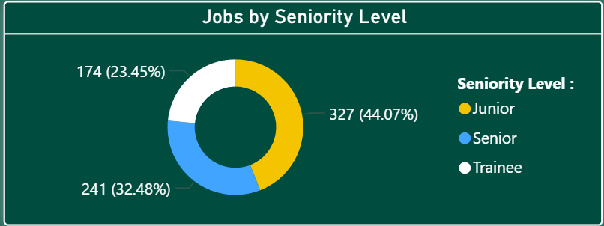
Junior roles dominate the market with 44.07%, indicating strong demand for early-career professionals.
Senior positions hold 32.48%, showing consistent hiring for experienced candidates.
Trainee roles form 23.45%, reflecting good entry-level opportunities but lower demand compared to junior roles.

Slide 4
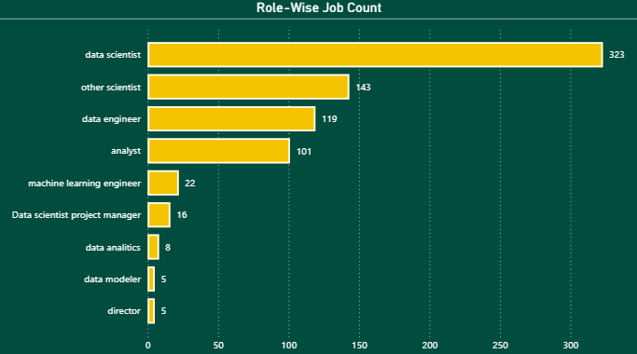
Data Scientist is the most in-demand role with 323 openings, showing highest market demand.
Other Scientist (143), Data Engineer (119), and Analyst roles (101) form the strong mid-tier demand cluster.
Specialized roles like Machine Learning Engineer (22), Data Scientist Project roles (16), Data Analytics (8), and Data Modeler (5) have lower but niche demand.

Slide 5
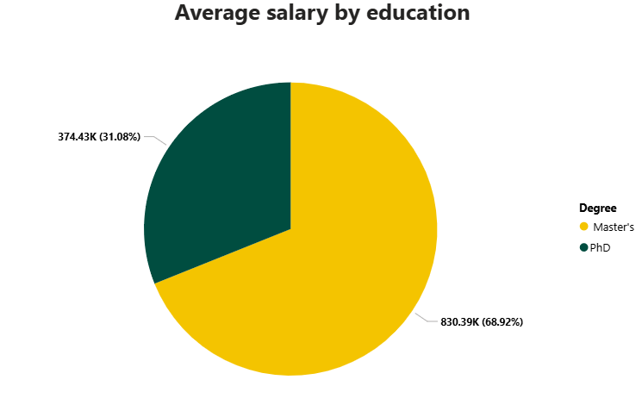
Candidates with a Master’s degree earn the highest share of total average salary, accounting for 68.92% (830.39K).
PhD holders contribute 31.08% (374.43K) to the total average salary, reflecting strong but comparatively lower market representation.
Overall, the data shows that Master's degrees command higher average salary influence in the job market compared to PhDs.

Slide 6
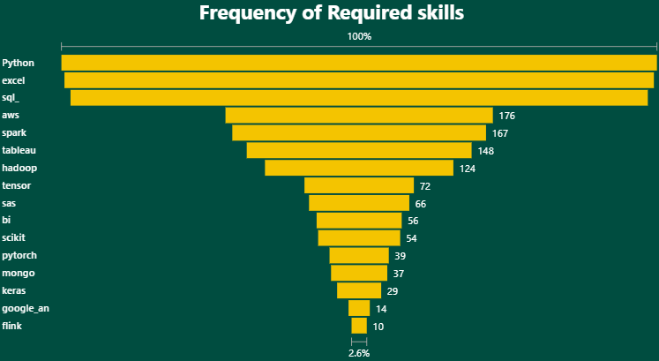
Python, Excel, and SQL are the top three most demanded skills, forming the core requirement for most job roles.
Cloud and big-data tools like AWS (176), Spark (167), and Hadoop (124) show strong demand, highlighting the shift toward scalable data systems.
Specialized ML/AI skills such as TensorFlow, SAS, BI tools, Scikit-learn, and PyTorch are required moderately, indicating targeted demand for advanced analytics roles.

Slide 7
1. With Data Scientist roles dominating the market, other positions include Data Engineer and Analyst, which also signals highly sought-after analytical and technical expertise.
2. Python, Excel, and SQL are still the most in demand skills, thus necessary to be employable in any industry.
3. Junior-level positions form the largest share, showing that organizations prefer to hire early career talent with strong foundational skills.
4. The average salary for Master's degree holders is higher, indicating a stronger market value for postgraduate education in data-related positions.
5. States like CA, IL, and DC offer the highest salaries, which indicates appealing regions for career growth in technology and analytics.
6. Industries with the largest job volumes include Biotech, Pharma, Insurance, and IT, with strong hiring momentum in innovation driven sectors.
7. Overall, job distribution shows clear patterns of required skill demand, salary variation, and geographical hubs that will help job seekers and businesses effectively align hiring, training, and career planning strategies.
CONCLUSION

Slide 8
SUGGESTIONS
1. Data Scientist, Data Engineer, and Analyst are leading the job market with a high demand for data-oriented talent. This further points out the continued industry movement toward analytics-driven decision-making.
2. Python, Excel, and SQL are the most critical skills, these three form the foundation of most high-demand roles. The investment in these core skills greatly enhances job readiness and competitiveness.
3. Junior-level positions dominate the hiring landscape, meaning firms prefer entry level talent that is scalable. This trend is indicative of strong opportunities for freshers and early career professionals.
4. Master's degree holders have higher average salaries than PhDs, which is indicative of strong ROI from professional degrees. Education still plays a key role in compensation and career advancement.
5. High-paying states like CA, IL, and DC and growth-heavy industries like Biotech, Pharma, and IT are the drivers of the job market. The clusters showcase the areas where job seekers can target to get better salaries and long-term growth.

Slide 9
THANK YOU!

